Slide 1

STAT 689 Class Project
STAT 689 Class Project
To Tip or not to Tip – that’s the question!
Predicting Chicago Taxi
Presented by –
Abhilash Tangadpalliwar & Debapriyo Paul

Slide 2
Our Agenda
2
4
Introduction
Data
Cleaning
Data Information
Data Exploration
1
3
5
7
Model
validation
Model building
Strengths & challenges
Key Learnings
6
8

Slide 3
Introduction
The City of Chicago in November of 2016 released a public dataset containing information over 100 million taxi rides since 2013 (https://data.cityofchicago.org/Transportation/Taxi-Trips/wrvz-psew/data)
This public dataset does not include any data from the rideshare services like Uber and Lyft, but in 2015, the taxi-owners association of Chicago claimed that Uber and Lyft have caused them a loss of 30-40% in business
Uber and Lyft started their operations in Chicago in 2011 and 2013 respectively

Slide 4
Data Information
Fields
Taxi ID
Trip ID
Trip Start and End Time
Trip Duration
Trip Distance
Fare
Payment Type
Taxi Company
Pickup & Dropoff Location, etc.
Limitations
Trips not reported in real time
Masking of Taxi ID
Exact Pickup & Dropoff Location unknown
Location available on Census Tract and Community area level
Census Tracts not available for ¼ trips

Slide 5
From Source
From our side
Data
cleaning
Handling erroneous values – e.g. trip duration
Data
preprocessing
Model build
Removing duplicates and redundant fields
Parsing pickup and drop-off timestamps
Replacing Trip ID with an index
>
Dataset for prediction
<
If you don’t pre-process, you Re-process

Slide 6
Data Cleaning from the provider’s side
Trip times less than zero or greater than 86,400 seconds (1 day) are removed
Trip lengths less than zero or greater than 3,500 miles are removed (max distance from Chicago)
If any component of the trip cost is less than $0 or greater than $10,000, all components of the trip cost are removed
De-duplication of taxi trips
Notes:
Deduplication criteria:
If all these fields are similar, then deduplicated the trips
Taxi ID
Trip Start and End Timestamps
Trip Seconds
Trip Miles
Pickup and Dropoff Census Tracts (after blanking out for privacy, if necessary)
Pickup and Dropoff Community Areas

Slide 7
Data Preprocessing from our side
Removed records if pickup and/or drop-off timestamp, Taxi ID, or Community Area for pickup/drop-off is null
Parsing of timestamp to extract date, hour, minute for pickup and drop-off
Fare converted to “float” data type (removal of $ prefix)
For payment type = “Cash”, tips are not recorded in the system so we assumed tip value = 0

Slide 8
Data Preprocessing from our side (contd.)
Minimum Fare was assumed to be $3.25 (as per City of Chicago) and maximum fare was assumed to be $1000, so the records having all the fares falling outside this range were removed
Removed all the records having trip duration more than 12 hours (maximum permissible working time for Chicago taxi driver)
Removed “Trip ID” and instead added a unique numeric index
Removed “Centroid location” and “Pickup O’Hare Community area” fields since they were redundant
Notes:
The Trip ID is a huge string of almost 30 characters whereas “Centroid Location” and “Pickup O’Hare Community Area” are redundant fields
All this Data Cleaning hugely reduced the size of the data that was earlier ~40 GB to around 10-12 GB
This significantly reduced the computational time taken for data loading and analysis

Slide 9
Data Loading
Data Exploration and Modeling was performed in Google Colaboratory since it uses an accelerated GPU and doesn’t require PC’s memory for handling ~40 GB data
Read data to Python in chunks
Convert to SQLite3 DB
Query data
Split data into smaller CSVs
Used Google Colab for analysis

Slide 10
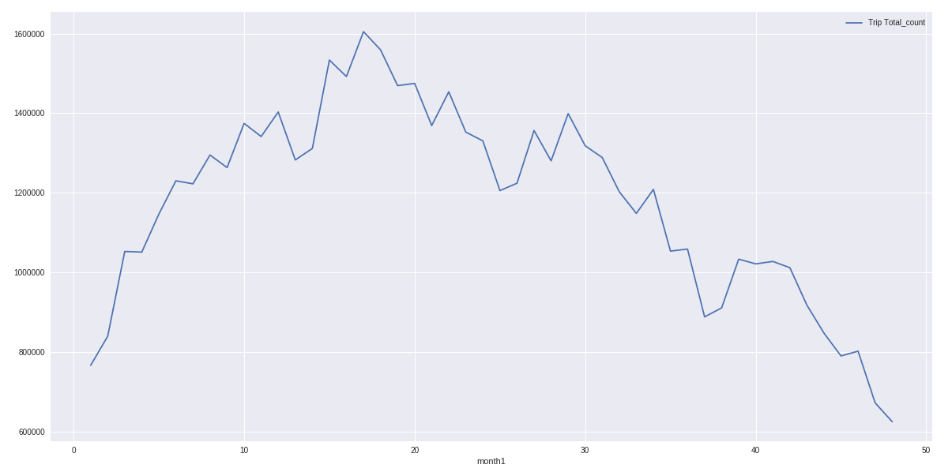
Data Exploration
2015
2016
Decreasing through the years
2013
2014
Chicago Taxi Trips in numbers over the years (2013-2016)

Slide 11
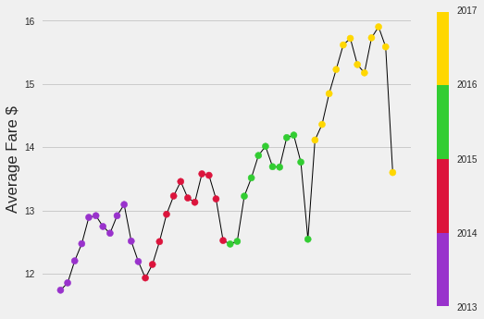
Data Exploration
Increasing through the years
Average Taxi Fares over the years (2013 to 2016)

Slide 12
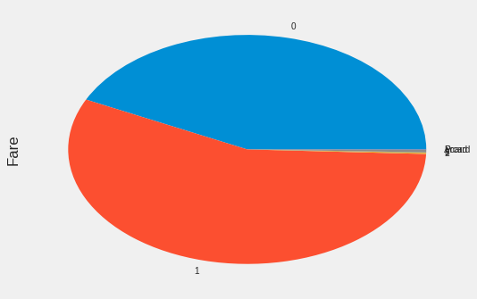
Data Exploration
Credit Cards (42%)
Prepay Cards, Vouchers (2%)
Cash (56%)
Typical distribution of Payment Types for Taxi fares

Slide 13
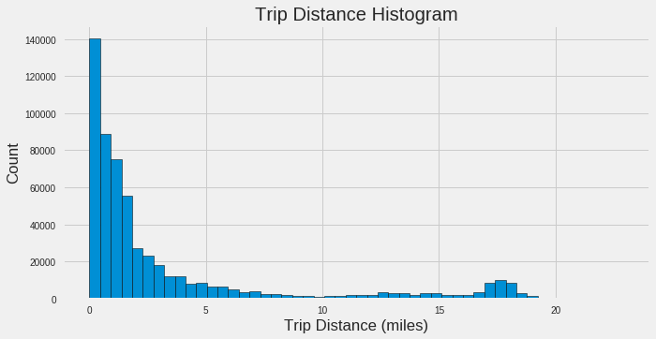
Data Exploration
Most trips < 5 miles
Histogram of no. of trips with Trip Distance

Slide 14
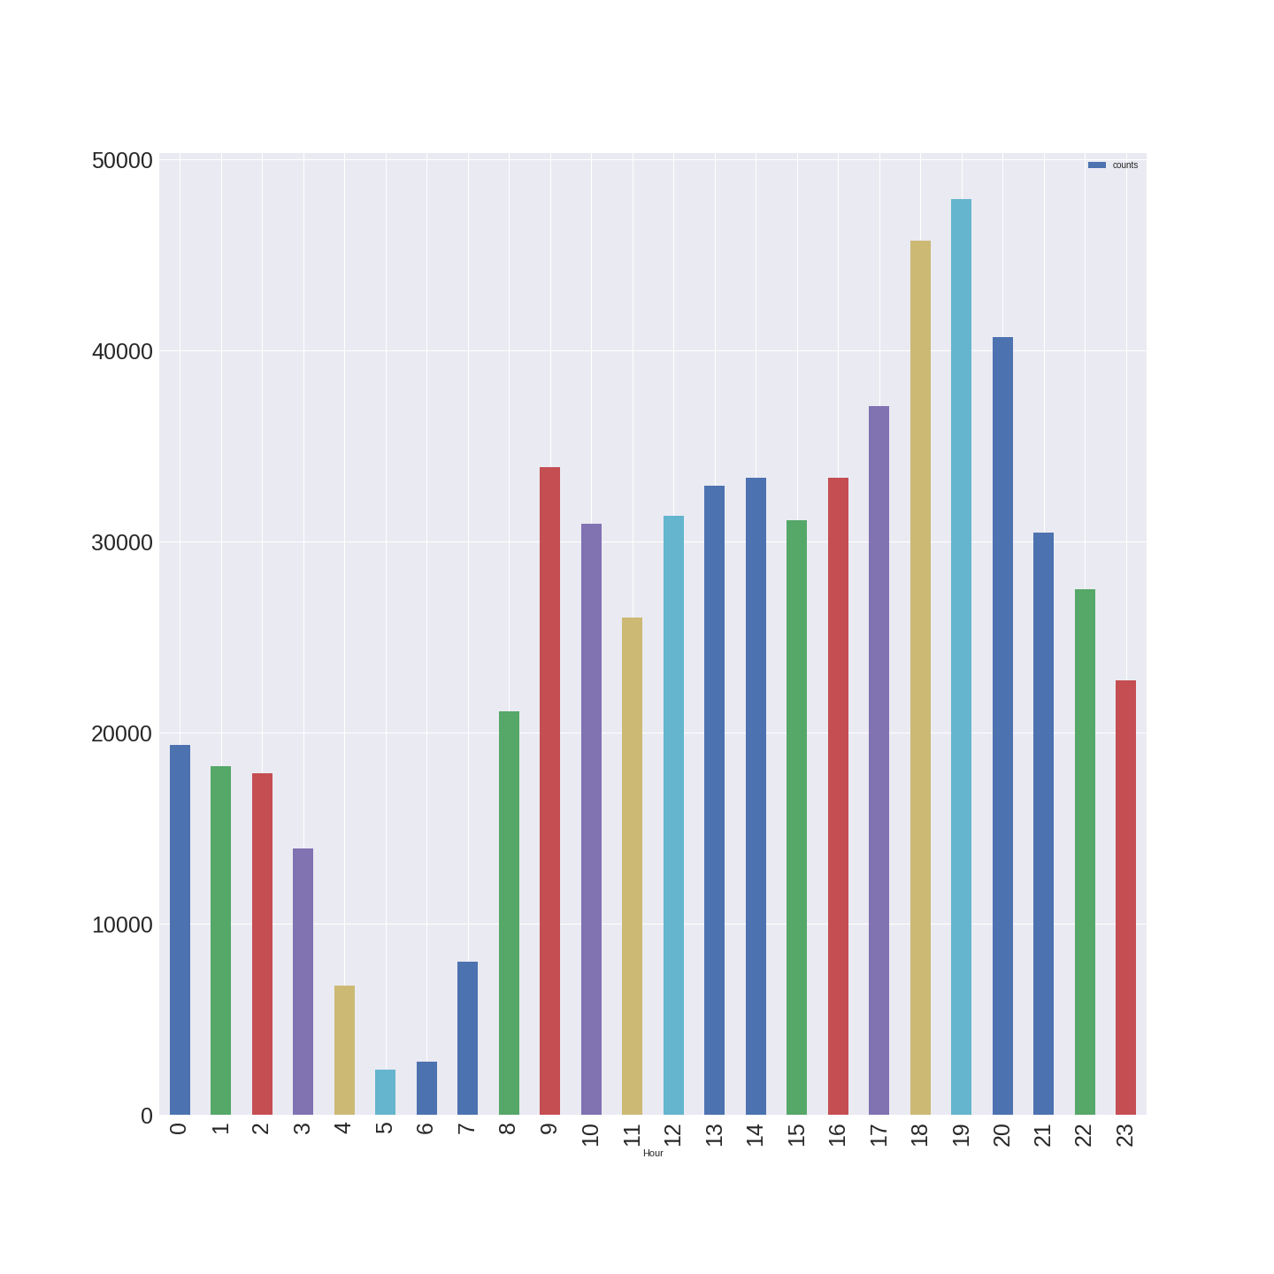
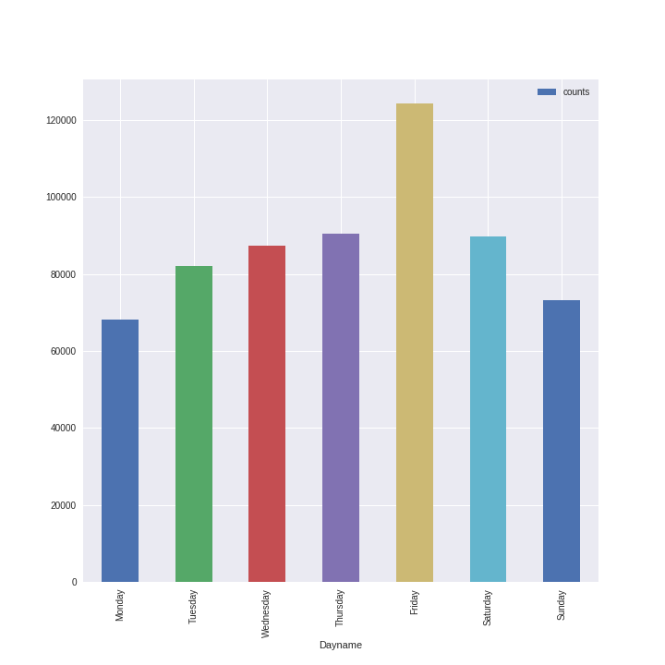
Data Exploration
8-10 am
5-8 pm
TGIF
Hour-wise trips on a Typical Day
Day-wise trips on a Typical Week

Slide 15
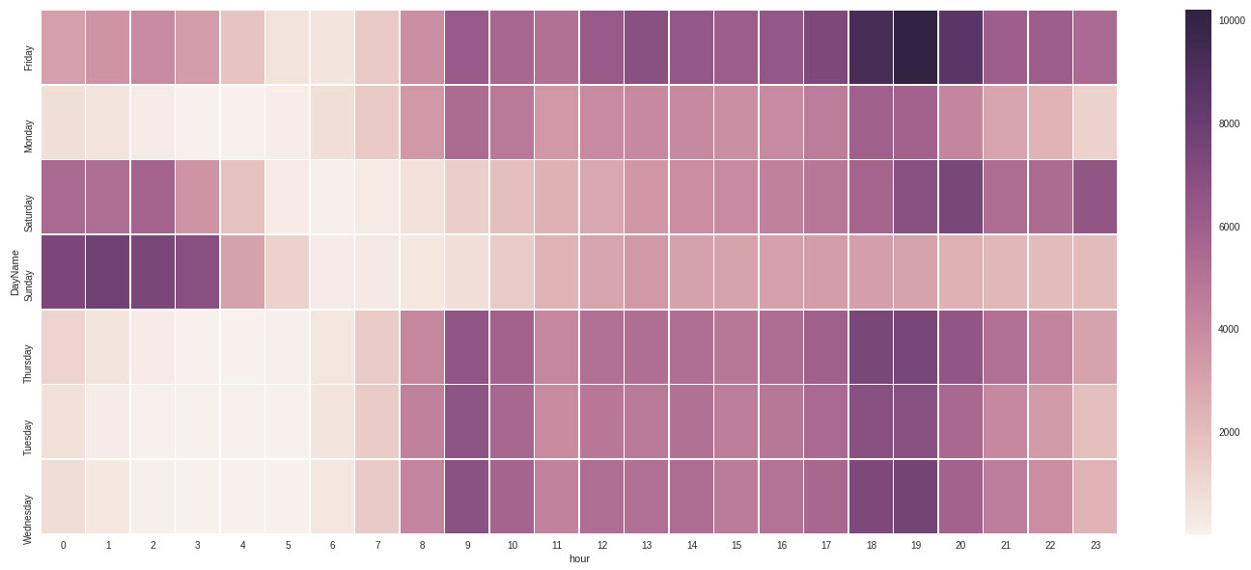
Data Exploration
Friday Evening
Weekend Midnight
Heatmap for Day-wise and Hour-wise Trips

Slide 16
Data Exploration
Downtown
Airports
Community-area wise Pickups (2013 v/s 2016)

Slide 17
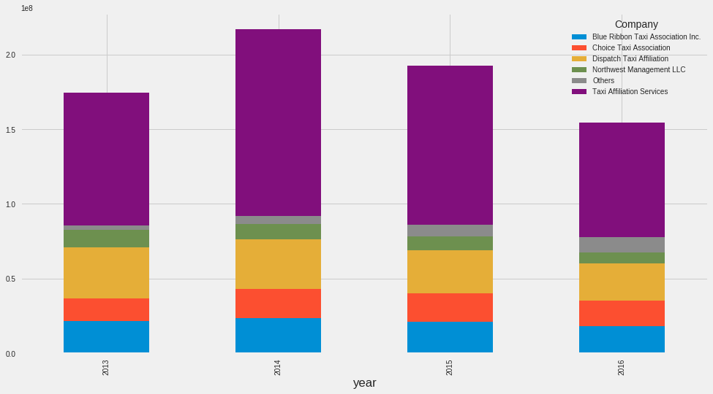
Data Exploration
58%
55%
51%
50%
2%
2%
7%
5%
4%
5%
7%
15%
5%
19%
15%
16%
9%
9%
10%
11%
12%
11%
11%
11%
Market-share of Taxi Companies over the years

Slide 18
Data Exploration
2013
2016
Community area-wise pickups for Top 5 Taxi Companies over the years (2013 v/s 2016)

Slide 19
Data Exploration
Community area-wise pickups for KOAM Taxi Association (2013 to 2016)

Slide 20
Model Building – Part 1
Goal is to predict “Fare”
Regression
Random Forest

Slide 21
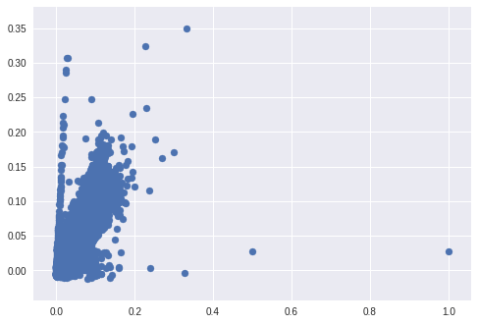
Regression Results
R² = 81%
Regression Equation
y = 0.4678*(trip_seconds) + 0.2904*(trip_miles) +
0.0214* (pickup_community) + 0.0152* (dropff_community) + 0.0015 * (day_name) – 0.0026*(hour)
Scatterplot for Predicted V/s Actual Responses (Normalized)
Notes:
Removed records where Tip% > 100%

Slide 22
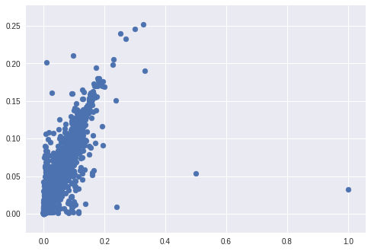
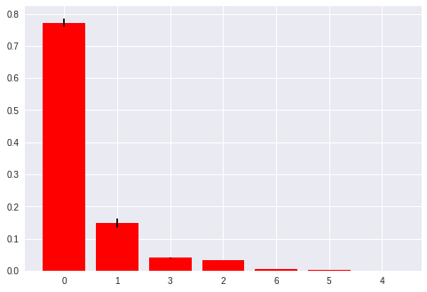
Tuned Random Forest Regressor
R² = 92%
Trip Seconds
Trip Miles
Dropoff Area
Pickup Area
Hour
Day
Scatterplot for Predicted V/s Actual Responses (Normalized)
Feature Importance (Tuned Random Forest)
Notes:
Removed records where Tip% > 100%

Slide 23
Model Building – Part 2
Attribute of Interest = Tips
Tips contribute a major share of taxi drivers’ take-home income
Which factors affect tips?

Slide 24
Model Building
Our attribute of interest is predicting the tip value on the Chicago taxi rides for a particular time period
Tips constitute a large share of the taxi drivers’ income and hence we are interested to know how this value changes with different parameters
Does it depend on pickup/drop-off location, time of the day, taxi company, trip distance, trip duration, etc.?
Resulting model will be able to predict if a customer will give a tip at the end of a particular ride and if yes, how much that amount would be
Findings can help the taxi companies improve their strategies and services so as to benefit the taxi driver’s supplemental income

Slide 25
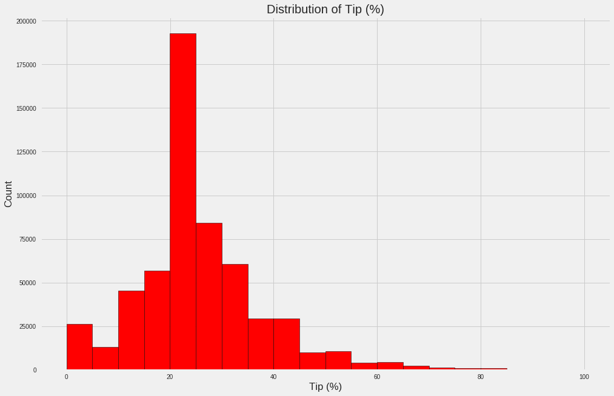
Tips – How do they look?
Average Tip ~ 25%
Histogram of % Tip value
Notes:
Removed records where Tip% > 100%

Slide 26
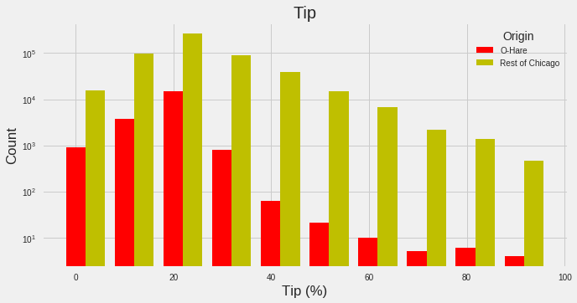
Tips – How do they look?
p-value = 0
Different Distributions
Histogram of % Tip value for O’Hare vs Rest of Chicago Pickups

Slide 27
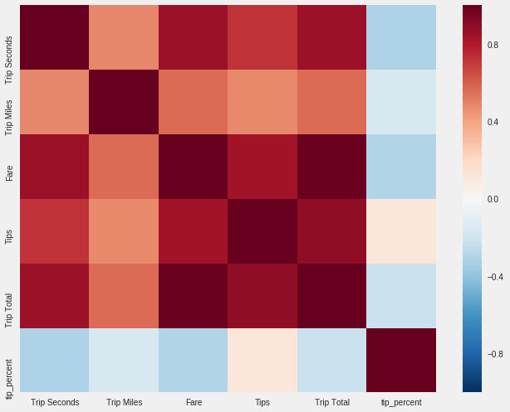
Tips or Tip % ?
Hypothesis: Almost no linear relationship with other continuous variables
Relationship heatmap between variables
Notes:
Therefore, we hypothesize that random forest would give a better prediction that logistic regression

Slide 28
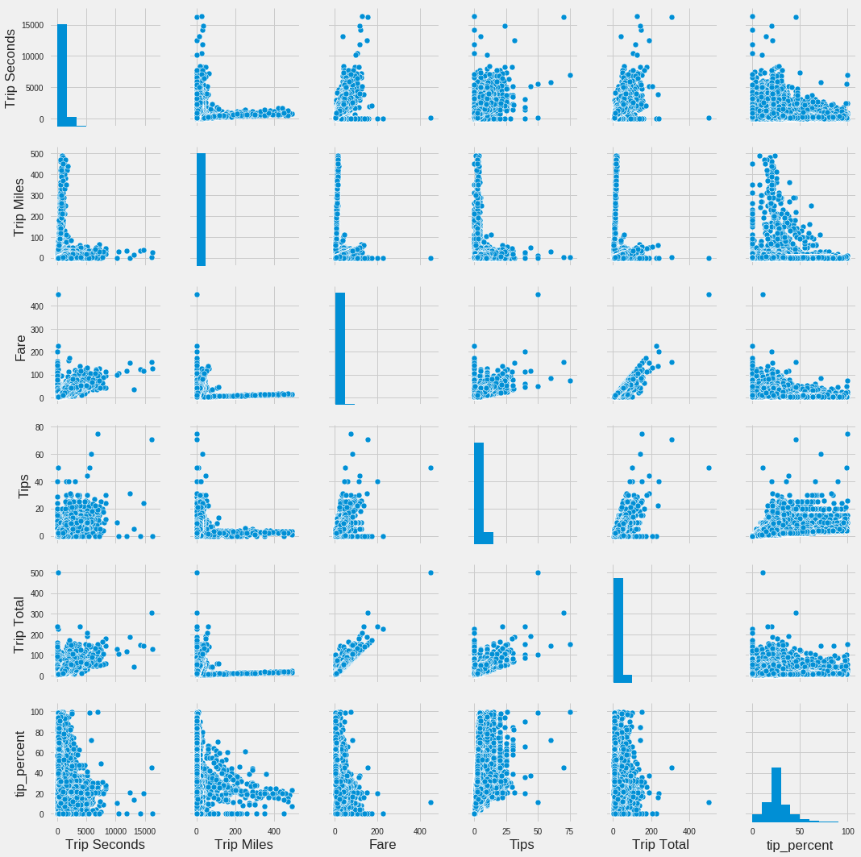
Pair Plot
between variables
Notes:
Therefore, we hypothesize that random forest would give a better prediction that logistic regression since there is almost no linear relationship

Slide 29
Data Imbalancing
4% - 96% imbalance
Only 4% records have 0 tips
Under sampling
Separated those 4% records from rest of the data
Training Data
Sampled observations from 96% dataset in a ratio of 3:1 to the 4% dataset
Imbalance poses a challenge in classification
Used rest 96% data for sampling
Notes:
1-year representative data used as training dataset
Initial Training Data is 80% of actual Data whereas Test Data is 20% of actual data

Slide 30
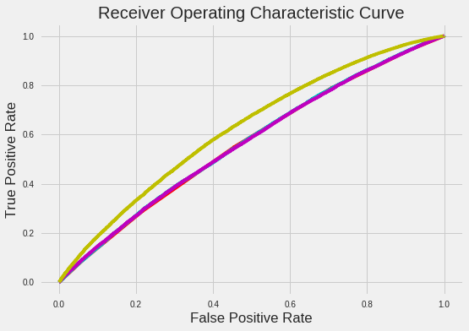
Classification Models and their Accuracy
68%
Untuned RF
60%
57%
54%
Tuned RF
Logit
LDA
Tuned
RF
Untuned
RF
LDA
Logit
Notes:
Parameters to vary:
n_estimators = max no of trees,
Number of features to consider at every split
Maximum number of levels in tree
Minimum number of samples required to split a node
Minimum number of samples required at each leaf node
Method of selecting samples for training each tree
Tuning performed on over 4000 settings

Slide 31
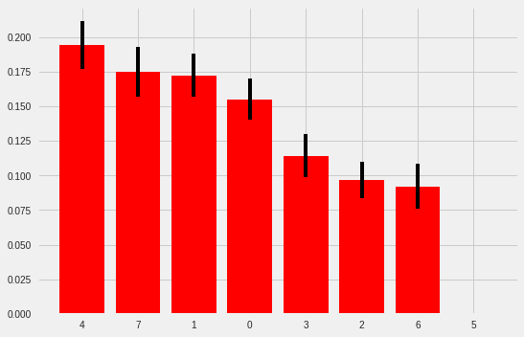
Feature Importance (Tuned Random Forest)
Fare
Hour
Miles
Duration
Dropoff area
Pickup area
Day of the week

Slide 32
Strength & Limitations
YES to Big Data
Collinearity is not a curse
Highly performant
Our methodology helps analyse huge datasets even ~40 GB ones
RF model ensures that performance is unhindered by non linear relationships
Easy implementation, validation and testing
Significantly high computation time even with GPU accelerated system
Route Prediction is not possible due lack of relevant information, etc.
Computation Time
Data Inadequacies

Slide 33
What we learnt?
Predictive Modeling
is like a sandbox
Do not underestimate data preprocessing
Requires Creativity
Can (attempt to) predict anything
80/20
Key
Learnings
Perhaps disproving something still carries value
Go for it
Taxi Drivers will thank you!
Can change your point of view

Slide 34
Thank You!
#BTHOFinals
P.S. Don’t forget to tip the cabbie ;)

